Slide 1
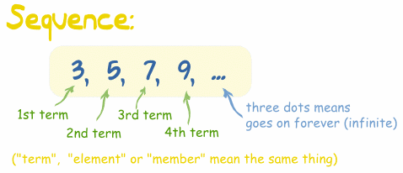
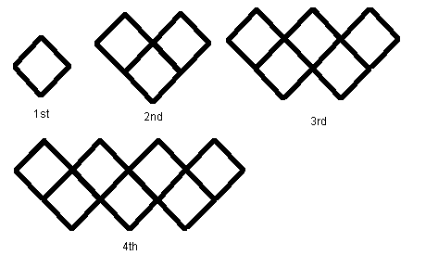

Sequences Challenges

Slide 2
Challenge 1
Write down the next two numbers in each of these sequences and write down your reasons?
2, 5, 8, 11, …, …
3, 8, 13, 18, …, …
1, 8, 15, 22, …, …
15, 8, 1, -6, …, …
1, 2, 4, 8, …, …
18, 14, 10, 6, …, …

Slide 3
Challenge 2
Draw the next 4 diagrams and complete the table of results
Pattern number | 1 | 2 | 3 | 4 | 5
Matches used | 4

Slide 4
Challenge 3
Complete these sequences and write down your reasons?
7, 10, …, …, …, 22
1, …, …, …, 17, 21
…, …, 10, …, 12, …
9, …, 21, …, 33, …
6, …, …, …, …, 26
…, 7, …, …, -8, …

Slide 5
Challenge 4
How many matches needed for the 10th diagram?
Pattern number | 1 | 2 | 3 | 4 | 5
Matches used | 6

Slide 6
Challenge 5
Plot the points (1,5) (2,9) etc on a set of axes. What do you notice and why does it happen?

Slide 7
Challenge 6
Complete the table below?
Shape | 1st | 2nd | 3rd | 4th | 5th | 20th
3 x table | 3
No. of Cubes | 4 | 7 | 10 | 13 | 16

Slide 8
Challenge 7
How many chairs would you need if there were 50 tables?

Slide 9
Challenge 8
The 1st term of a sequence is 7 and the 5th term is 33.
What is the 60th term?

Slide 10
Challenge 9
Write down the first 5 numbers in each of the sequences described below?
3n + 1
4n - 3
2n + 5
n + 3
12 – 3n
7n + 6

Slide 11
Challenge 10
Match the sequence with the formula?
-1, 4, 9, 14, …
8, 15, 22, 29, …
9, 13, 17, 21, …
5, 7, 9, 11, …
4n + 5
7n + 1
2n + 3
5n – 6

Slide 12
Challenge 11
Find the formula that gives the nth term
Term
1st
2nd
3rd
4th
5th
…
nth
2
8
14
20
26
7
12
17
22
27
9
11
13
15
17
-3
-2
-1
0
1
3
4
5
6
7

Slide 13

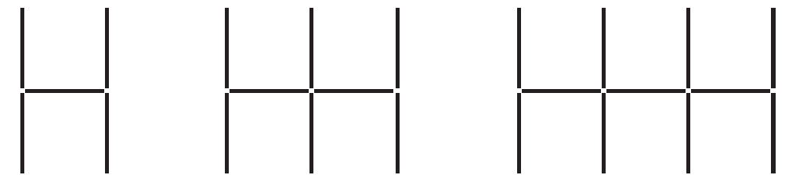
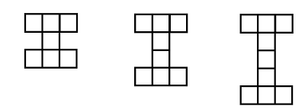
Challenge 12
Find the 3 formulas that give the number of matches needed for these patterns

Slide 14
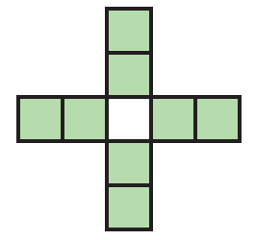
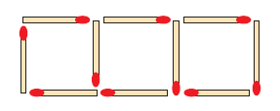
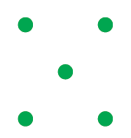
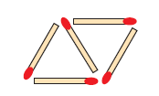
Challenge 13
By looking at the diagrams below work out how many squares, dots or matches in diagram 50
Diagram 3
Diagram 3
Diagram 2
Diagram 2
Diagram 1

Slide 15
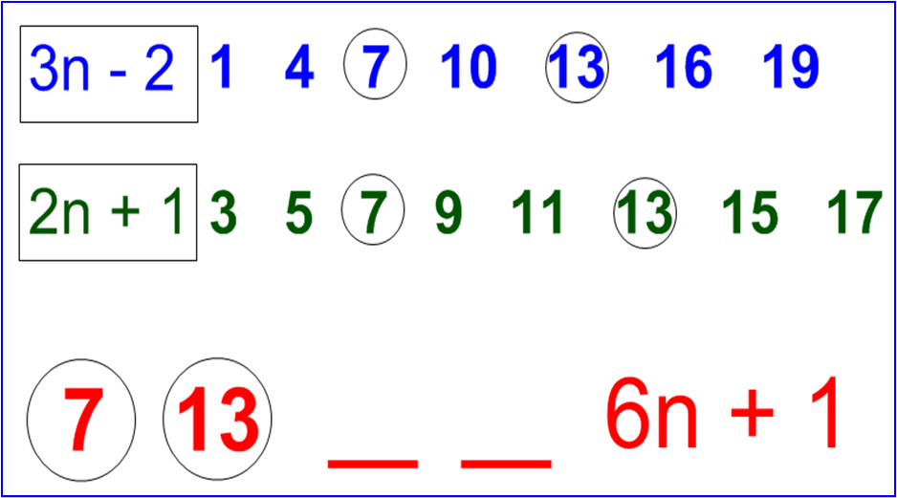
Challenge 14
Explore this further

